Slide 1








X-PERT: Accurate Identification of Cross-Browser Issues in Web Applications
Shauvik Roy Choudhary, Mukul Prasad, Alessandro Orso
Labs of America
Partially supported by
Notes:
Thank you for the Introduction.
Today I'll present X-PERT, our latest work on detecting Cross-Browser Issues in Web Applications.
This work was done in collaboration with Mukul Prasad, from Fujitsu Labs, and my advisor Alex Orso, and was partially supported by NSF, Microsoft Research, and IBM Research.

Slide 2















Web Applications
Notes:
Web Applications are ubiquitous, and we increasingly use them for our day-to-day activities.
Developers love Web apps because they can write them once and make them available everywhere.
All the users need is just a Web Browser!
But this is based on the assumption that web applications behave in the same way on all platforms and web browsers, which is unfortunately not the case.
Web apps can in fact behave differently on different browsers, and this can negatively affect the user experience, sometimes in dramatic ways.
Let me show you some examples of this.

Slide 3

Notes:
This first example is close to our heart because it is our institutional website GATech.edu, and this page is from the day our school's dean was announced. Let's look at the news section in Firefox and IE.

Slide 4


Mozilla Firefox
Internet Explorer

Slide 5
Mozilla Firefox
Internet Explorer
Notes:
As you can see, some elements on the page are misaligned. This does not look good, clearly, but you may think it is not a big deal.

Slide 6
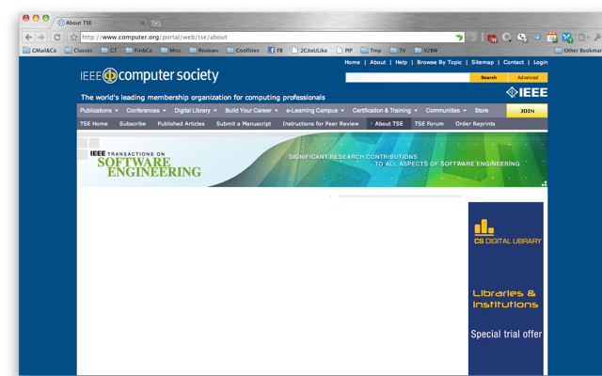


Google Chrome
Notes:
So, let's look at another example.
Say, you have a paper at ICSE and want to submit a journal version to IEEE TSE.
Before submitting, you probably want to know who may handle your paper, so you look at the associate editors page.
Let's say you work on a Mac, and use Chrome to do this. If you were to do that in 2010, this would be the result: a white page.

Slide 7
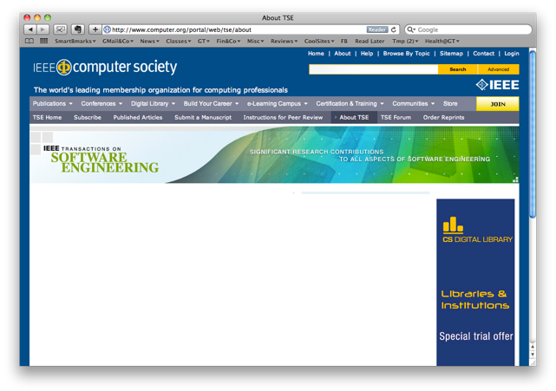
Apple Safari
Notes:
You may then give it another shot with Safari, the native browser on the Mac… still no information.

Slide 8
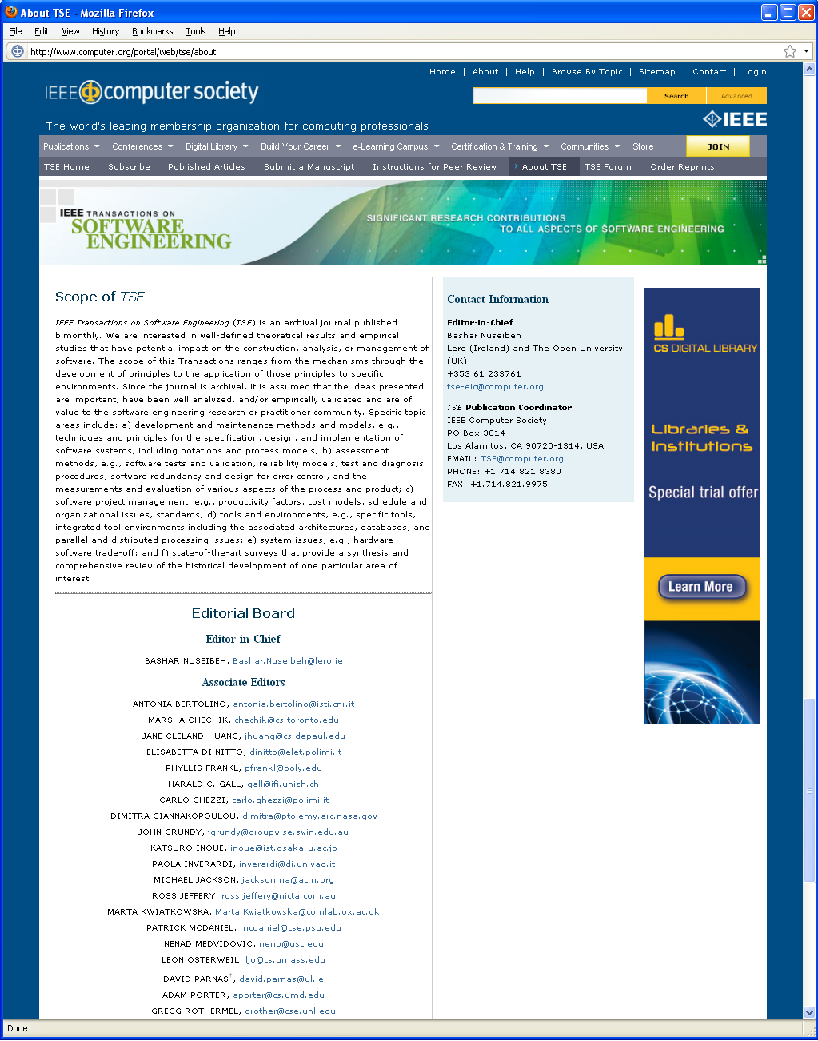
Apple Safari
Mozilla Firefox
Notes:
Finally, if you try with Firefox, you would get the information you are looking for.
Also in this case, this is a visual issue, but it is really affecting your experience, as it would prevent you from getting the information you are looking for, and maybe would make you submit to a different journal.

Slide 9

Mozilla Firefox
Notes:
And if you are not yet convinced, let me show you one last example.
This is GrantaBooks.com, a leading publisher in the UK, and this is how their website looks in Firefox.

Slide 10

Mozilla Firefox
Internet Explorer
Notes:
If you were to open the same website in Internet explorer, you would find that the menus and links on the website are completely missing.

Slide 11
Mozilla Firefox
Internet Explorer
?
?
Notes:
So, this site is basically useless for IE users. Neither can they go past the homepage to read book reviews, nor can they buy any books. In this case, GrantaBooks would clearly be loosing revenue.

Slide 12






Web Developer
Notes:
So, why do these problems actually happen? When web developers write these applications, they typically debug and test in one browser. But when they deploy their web apps, they need to support all the browsers that users use.

Slide 13
Web Developer
Notes:
And not just all browsers but all browser versions.

Slide 14




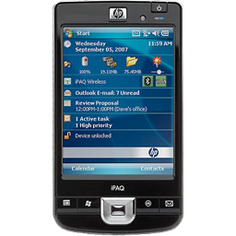


Web Developer
Notes:
And even worse, all these versions running on different devices and operating systems.
So how many different browser versions are out there?

Slide 15
1211
Browser versions last year
Source: StatCounter.com
Notes:
We looked at statistics and found that there are more than 1,200 browser versions.
Even if you wanted to target only the most widely used browsers, say those with more than 1% market share,
that number is still bigger than 50! Which is a lot!

Slide 16
56
Browser versions last year
with at least 1% market share
150mn visits/month (StatCounter.com)
Notes:
So, how do companies actually handle this? Typically they select a subset of browsers they want to support.

Slide 17
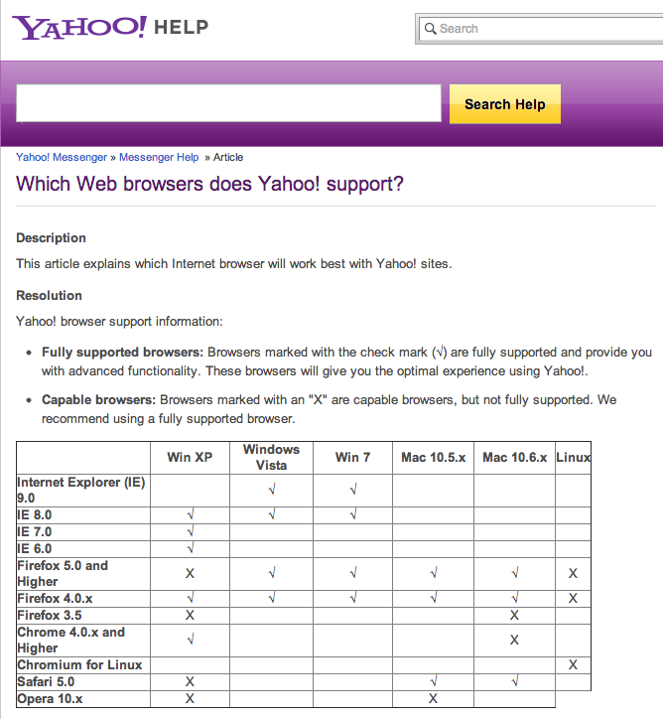
Notes:
This browser support page from Yahoo, for instance, shows that they support all these different configurations of browsers.

Slide 18
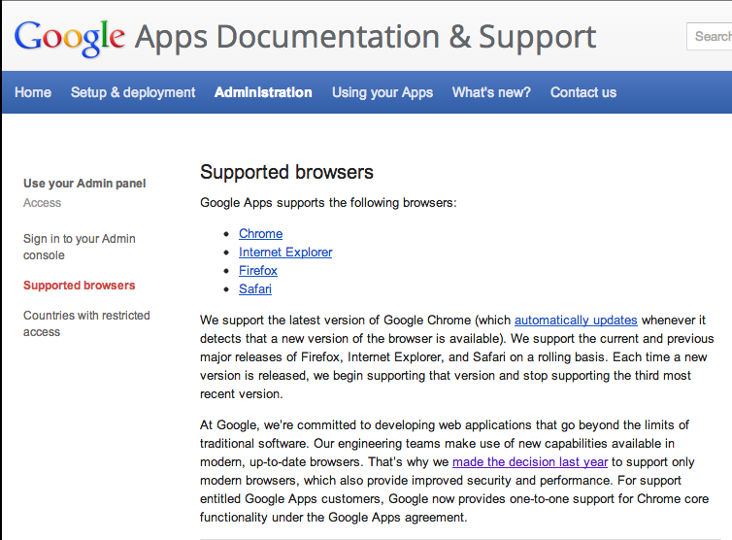
Notes:
Google supports even fewer browsers: the last 2 versions of the listed browsers.

Slide 19
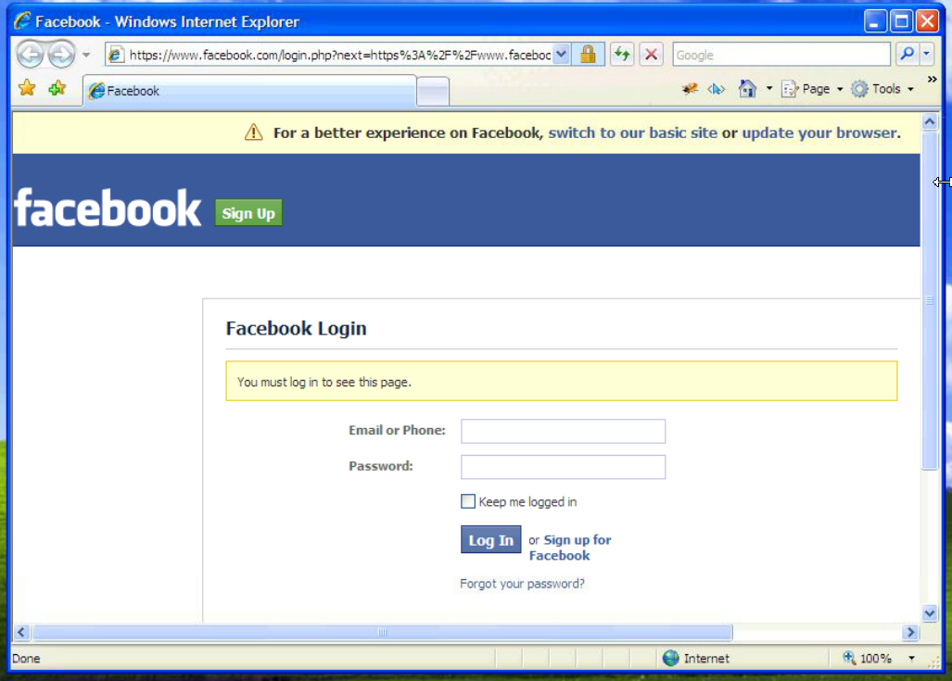
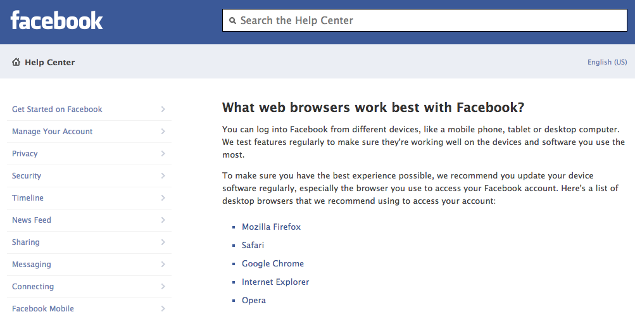
Notes:
Facebook supports even fewer: the latest version of these 5 browsers. And if you happen to run an older browser version, you will be asked to update your browser or switch to a site with limited functionality.
And despite this, from our experience interacting with companies, we know that they still face cross-browser issues in the supported browsers.
But why is it so hard to fix these issues? What are the challenges involved in detecting and eliminating them?

Slide 20
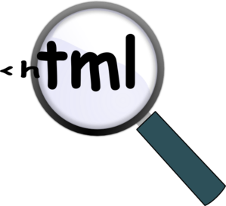

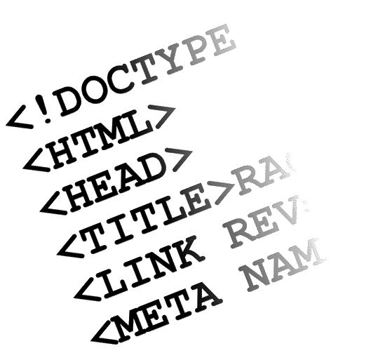


Challenges
Manual inspection
is expensive
Modern apps have
many dynamic screens
DOM differs
between browsers
Mimic end user’s
perception
Produce readable,
effective & actionable
reports
Engineering
Issues…
Notes:
- One natural way to do this, would be manual inspection. That's effective, but it is extremely expensive, and almost impractical, to check each page in each browser;
- And if we want to automate, we must consider that modern apps have multiple dynamic screens, and any automated technique must be able to reach and explore such screens.
- Moreover, the actual comparison of pages cannot just diff HTML pages, but needs to compare the structure represented by DOM trees. And this structure is different in different browsers, making the comparison very challenging.
- And even if you were able check this structure, it would not tell you how the site actually looks. Hence you need to mimic end users' perception.
And once a technique has identified the list of issues. you also need to present them in a way that is human readable, effective, and actionable.
And finally, getting this to work in practice involves tons of engineering issues that must be suitably addresses.
Let me now discuss you how researchers, and our group in particular, have tried to detect Cross-browser issues.

Slide 21
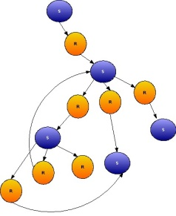
Detection of Cross-Browser Issues (XBI)
δ
δ
Error Report
Web Application
Model Generation
Model Comparison

Slide 22

Model Definition and Comparison
Screen Model
WebDiff [ICSM’10]
Roy Choudhary and Orso
DOM Tree
Screen Transition Graph
CrossT [ICSE’11] Mesbah and Prasad
Screen image
+ geometry
CrossCheck [ICST’12]
Roy Choudhary, Prasad and Orso
Notes:
Over the past couple of years, we, along with our colleagues have developed several techniques to detect cross-browser issues.
These techniques are fairly mature and worked well on limited case studies we have done with them.
But we wanted to see their applicability on larger set of subjects.

Slide 23

Study of Real World Cross-Browser Issues (XBIs)
Examined 100 websites
Found 23 with XBIs
XBI Types
Behavioral XBIs
Content XBIs
Structural XBIs
Random URL Generator
9%
Text
Visual
22%
30%
57%
Notes:
Structural XBIs:
Issue in structure or layout of individual elements
Content XBIs:
Difference in textual or visual content of individual elements
Behavioral XBIs:
Difference in behavior of individual functional components

Slide 24
Limitations of existing techniques
Miss Structural XBIs
Focus on symptoms rather than causes
Duplicate reports
Low Precision

Slide 25
Comprehensive XBI Detection
Behavioral XBIs
Content XBIs
Structural XBIs
Text
Visual
Notes:
Structural XBIs:
Issue in structure or layout of individual elements
Content XBIs:
Difference in textual or visual content of individual elements
Behavioral XBIs:
Difference in behavior of individual functional components

Slide 26
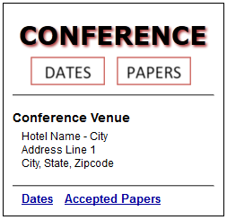
Example

Slide 27

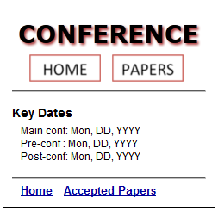
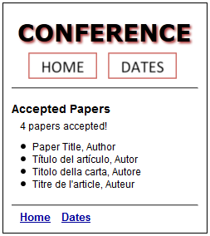
Example

Slide 28


Example
Behavior XBI
9%

Slide 29
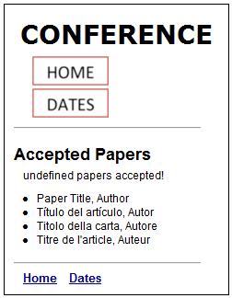
Example
Content XBI
(Visual) – 30%
Structural XBI
57%
Content XBI
(Text) – 22%

Slide 30
Comprehensive XBI Detection
Behavioral XBIs
Content XBIs
Structural XBIs
Text
Visual
Notes:
Structural XBIs:
Issue in structure or layout of individual elements
Content XBIs:
Difference in textual or visual content of individual elements
Behavioral XBIs:
Difference in behavior of individual functional components

Slide 31
Comprehensive XBI Detection
Behavior check using
Graph Isomorphism
Behavioral XBIs
Content XBIs
Structural XBIs
Text
Visual
= ?
CrossT [ICSE’11] Mesbah and Prasad
CrossCheck [ICST’12]
Roy Choudhary, Prasad and Orso
Notes:
Structural XBIs:
Issue in structure or layout of individual elements
Content XBIs:
Difference in textual or visual content of individual elements
Behavioral XBIs:
Difference in behavior of individual functional components

Slide 32


Comprehensive XBI Detection
Text Content
check using
String equality
Behavioral XBIs
Content XBIs
Structural XBIs
Text
Visual
= ?
WebDiff [ICSM’10]
Roy Choudhary and Orso
CrossT [ICSE’11] Mesbah and Prasad
CrossCheck [ICST’12]
Roy Choudhary, Prasad and Orso
Notes:
Structural XBIs:
Issue in structure or layout of individual elements
Content XBIs:
Difference in textual or visual content of individual elements
Behavioral XBIs:
Difference in behavior of individual functional components

Slide 33

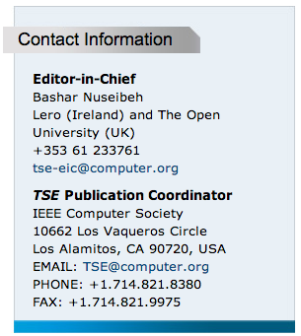
Comprehensive XBI Detection
Visual Content
check using
Image Matching
Behavioral XBIs
Content XBIs
Structural XBIs
Text
Visual
Computer
Vision
= ?
WebDiff [ICSM’10]
Roy Choudhary and Orso
CrossCheck [ICST’12]
Roy Choudhary, Prasad and Orso
Notes:
Structural XBIs:
Issue in structure or layout of individual elements
Content XBIs:
Difference in textual or visual content of individual elements
Behavioral XBIs:
Difference in behavior of individual functional components

Slide 34
Detecting Structural XBIs
Intuition: Disruption in the relative arrangement of web page elements leads to Structural XBIs
Idea: Abstraction to represent relative arrangement and compare it to expose errors
Notes:
EXAMPLE TO ILLUSTRATE

Slide 35
Alignment Graph (AG)
A graph capturing structural relationships between elements (rectangles) on the webpage
An AG has:
Containment relationships
Alignment relationships
Attributes
above
right-align
left-align
Notes:
The exact algorithm to compute AG is in the paper but let me show an example of how the alignment graph is constructed

Slide 36
Step 1: AG Construction
18
15
(x1, y1)
14
12
(x2, y2)
4
17
11
3
6
13
5
2
16
10
1
9
8
7
Notes:
Order -> Quadratic to Linear

Slide 37
Step 1: AG Construction a. Containment Relationship
e
(x1, y1)
(x1’, y1’)
e’
(x2’, y2’)
(x2, y2)
e contains e’ iff
( x₁ ≤ x₁’ ∧ y₁ ≤ y₁’ ∧ x₂ ≥ x₂’ ∧ y₂ ≥ y₂’ ) , and
if same bounds and XPath(e) ≤ XPath(e’)

Slide 38
Step 1: AG Construction a. Containment Relationship

Slide 39
Step 1: AG Construction b. Alignment Relationship

Slide 40
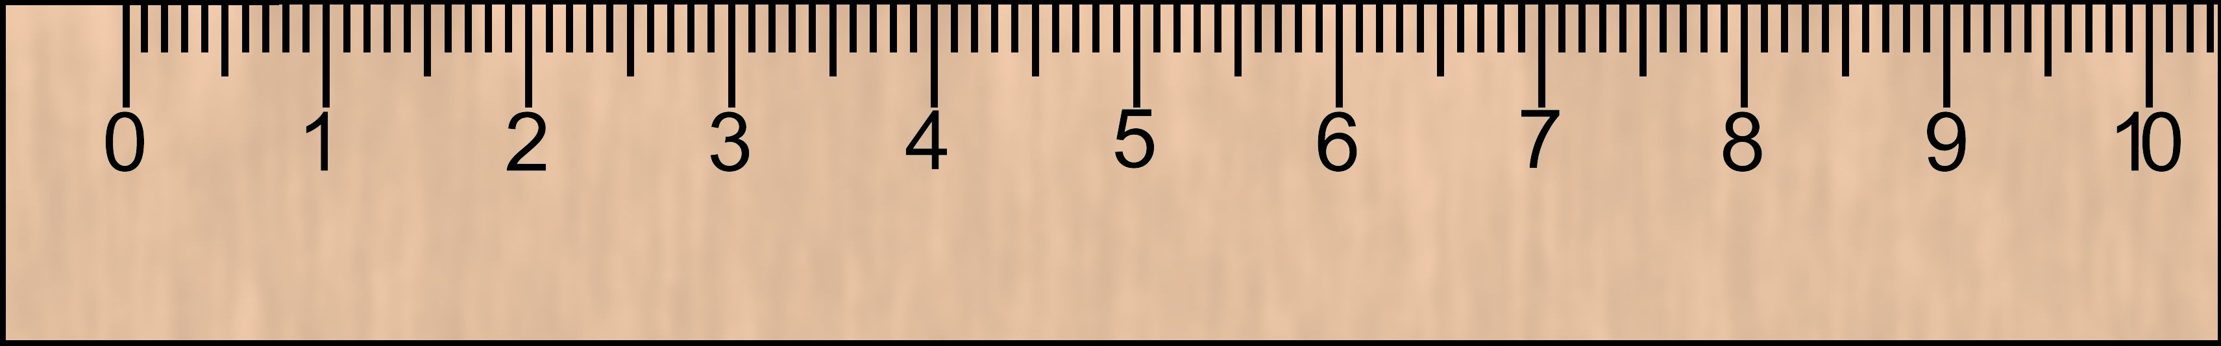
Step 1: AG Construction c. Attributes
y₁ = y₁’
x₂ < x₁’
leftOf
top-align
bottom-align
Button 1
Button 2
y₂ = y₂’
What alignment attributes can we infer?
Button 1 is on the left of Button 2
Button 1 and Button 2 have their tops aligned
Button 1 and Button 2 have their bottoms aligned

Slide 41
Step 1: AG Construction c. Attributes
leftOf
top-align
bottom-align
Button 1
Button 2

Slide 42
Step 2: Matching AGs

Slide 43
Step 2: Matching AGs

Slide 44
Comprehensive XBI Detection
Behavioral XBIs
Content XBIs
Structural XBIs
✔
✔
Behavior
Checker
Structure
Checker
Text
Visual
Text
Visual
Model Generation
Report
Generation
✔
Element
Matcher
Content
Checker
Model Comparison
Notes:
Structural XBIs:
Issue in structure or layout of individual elements
Content XBIs:
Difference in textual or visual content of individual elements
Behavioral XBIs:
Difference in behavior of individual functional components

Slide 45
Empirical Evaluation
Tool: X-PERT (Cross-Platform Error ReporTer)
Research Questions:
RQ1: Can X-PERT find XBIs in real web applications?
RQ2: How does X-PERT compare to the state-of-art?

Slide 46


Experimental Protocol
v/s
v14.0.1
v9.0.9
+
= XBIs
Subjects
Manual Check
(Ground Truth)
Ran X-PERT on Subject Applications
+
=
False Positives
& Negatives
Error Reports
Manual Check

Slide 47
Subjects
800 - 140K elements
Name | Type | States | Transitions | DOM Nodes (per screen)
 |  |  |  | max | min | average
Organizer | Productivity | 13 | 99 | 27482 | 10001 | 13051
GrantaBooks | Publisher | 9 | 8 | 37800 | 15625 | 25852
DesignTrust | Business | 10 | 20 | 26437 | 7772 | 18694
DivineLife | Spiritual | 10 | 9 | 140611 | 9082 | 49886
SaiBaba | Religious | 13 | 20 | 42606 | 524 | 12162
Breakaway | Sport | 19 | 18 | 45148 | 8191 | 13059
Conference | Information | 3 | 12 | 878 | 817 | 853
Fisherman | Restaurant | 15 | 17 | 39146 | 15720 | 21336
Valleyforge | Lodge | 4 | 12 | 5416 | 4733 | 5046
UniMelb | University | 9 | 8 | 15142 | 12131 | 13792
Konqueror | Software | 5 | 4 | 17586 | 15468 | 16187
UBC | Club | 7 | 7 | 20610 | 7834 | 12094
BMVBS | Ministry | 5 | 20 | 19490 | 12544 | 15695
StarWars | Movie | 10 | 9 | 28452 | 19719 | 22626
Prior Art (6)
Example and Survey (4)
Random (4)
Notes:
14 subjects

Slide 48
Effectiveness
NAME | XBI | BEHAVIOR |  | STRUCTURE |  | CONTENT |  |  |  | TOTAL
 |  |  |  |  |  | TEXT |  | IMAGE
 |  | TP | FP | TP | FP | TP | FP | TP | FP | TP | FP
Organizer | 10 | 1 | 0 | 9 | 0 | 0 | 0 | 0 | 0 | 10 | 0
GrantaBooks | 27 | 16 | 0 | 11 | 0 | 0 | 0 | 0 | 0 | 27 | 0
DesignTrust | 7 | 2 | 0 | 5 | 3 | 0 | 0 | 0 | 0 | 7 | 3
DivineLife | 11 | 7 | 0 | 3 | 6 | 1 | 0 | 0 | 0 | 11 | 6
SaiBaba | 5 | 2 | 0 | 2 | 9 | 0 | 0 | 0 | 0 | 4 | 9
Breakaway | 13 | 0 | 0 | 10 | 2 | 0 | 0 | 0 | 0 | 10 | 2
Conference | 7 | 2 | 0 | 3 | 0 | 1 | 0 | 1 | 0 | 7 | 0
Fisherman | 5 | 1 | 0 | 3 | 1 | 0 | 1 | 1 | 0 | 5 | 2
Valleyforge | 3 | 0 | 0 | 2 | 2 | 0 | 0 | 1 | 0 | 3 | 2
UniMelb | 2 | 2 | 0 | 0 | 0 | 0 | 0 | 0 | 1 | 2 | 1
Konqueror | 0 | 0 | 0 | 0 | 0 | 0 | 0 | 0 | 6 | 0 | 6
UBC | 0 | 0 | 0 | 0 | 0 | 0 | 0 | 0 | 0 | 0 | 0
BMVBS | 1 | 0 | 0 | 0 | 0 | 0 | 0 | 0 | 0 | 0 | 0
StarWars | 12 | 0 | 0 | 12 | 0 | 0 | 0 | 0 | 0 | 12 | 0
TOTAL | 103 | 33 | 0 | 60 | 23 | 2 | 1 | 3 | 7 | 98 | 31
RQ1:
Can X-PERT find XBIs in real web applications?
Answer: Yes
Notes:
Complete Spectrum of XBIs

Slide 49
Improvement
NAME | XBI | X-PERT |  |  |  | CROSSCHECK
 |  | Prec | FP | Recl | Dp | Prec | FP | Recl | Dp
Organizer | 10 | 100% | 0 | 100% | 0 | 80% | 2 | 80% | 13
GrantaBooks | 27 | 100% | 0 | 100% | 0 | 96% | 1 | 100% | 0
DesignTrust | 7 | 70% | 3 | 100% | 0 | 5% | 122 | 86% | 3
DivineLife | 11 | 65% | 6 | 100% | 0 | 29% | 24 | 91% | 3
SaiBaba | 5 | 31% | 9 | 80% | 0 | 7% | 53 | 80% | 10
Breakaway | 13 | 83% | 2 | 77% | 1 | 13% | 49 | 54% | 12
Conference | 7 | 100% | 0 | 100% | 0 | 100% | 0 | 100% | 0
Fisherman | 5 | 71% | 2 | 100% | 0 | 44% | 5 | 80% | 8
Valleyforge | 3 | 60% | 2 | 100% | 0 | 50% | 1 | 33% | 0
UniMelb | 2 | 67% | 1 | 100% | 0 | 7% | 27 | 100% | 0
Konqueror | 0 | NA | 6 | NA | 0 | 0% | 11 | NA | 0
UBC | 0 | NA | 0 | NA | 0 | 0% | 1 | NA | 0
BMVBS | 1 | NA | 0 | NA | 0 | 0% | 2 | 0% | 0
StarWars | 12 | 100% | 0 | 100% | 0 | 10% | 91 | 83% | 3
TOTAL | 103 | 77% | 31 | 95% | 1 | 32% | 389 | 74% | 52
X-PERT
Precision
= 77% (45%)
Recall
= 95% (14%)
RQ2:
How does X-PERT compare to the state-of-art?
Answer: X-PERT has better precision and recall
Notes:
Layout XBIs were most common and were detected by previous approaches though perturbation in other elements due to side-effects.
Detecting side-effects is unreliable and results in a significant reduction in precision.
In addition, there can be multiple side-effects, which when detected by different
X-PERT
Precision = 76%
Recall = 95%
CROSSCHECK+
Precision = 18%
Recall = 83%

Slide 50
Experimental Data & Tool
Release
Experiments (Crawl Data + Reports)
Layout testing algorithm implementation
http://gatech.github.io/xpert

Slide 51
Related Work
Industrial tools
Test Suites for Web Browsers – Acid and test262
MS Expression Web, BrowserShots, BrowserStack
Browsera, MogoTest, BrowserBite
Research techniques
Eaton & Memon [IJWET’07]
Dallmeier, Burger, Orth & Zeller [JSTools’12]
Notes:
Class of Industrial tools
Tests – check if browsers support different web technologies; still they don’t target XBIs
Browsera et al – more similar to our class of techniques
- only target specific issues; from experience, we know they have lots of false positives
Eaton & Memon
- early technique for static html
- manual effort to tag & doesn’t consider all the aspects of web apps
Dallmier et al
- Major contribution seems to be in Model capture phase

Slide 52


Contributions
New Structural XBI
Detection Algorithm
Study of Real World XBIs
Comprehensive
Technique to detect XBIs
Empirical evaluation
shows effectiveness

Slide 53
Thank You
Shauvik Roy Choudhary, Mukul Prasad, Alex Orso

